Slide 1

RUNGTA COLLEGE OF DENTAL SCIENCES & RESEARCH
TITLE OF THE TOPIC
VIRAL INFECTIONS OF ORAL CAVITY
DEPARTMENT OF ORAL PATHOLOGY & MICROBIOLOGY

Slide 2
VIRAL INFECTIONS OF ORAL CAVITY
GUIDED BY:-
DR. SIDDHARTH PUNDIR
DR. SUDHANSHU DIXIT

Slide 3
Specific learning Objectives
Core areas* | Domain ** | Category #
HERPES SIMPLEX VIRUS | COGNITIVE | MUST KNOW
VARICELLA | COGNITIVE | MUST KNOW
HERPES ZOSTER | COGNITIVE | MUST KNOW
INFECTIOUS MONONUCLEOUSIS | COGNITIVE | MUST KNOW
CYTOMEGAVIRUS | COGNITIVE | MUST KNOW
ENTEROVIRUS | COGNITIVE | MUST KNOW
RUBEOLLA | COGNITIVE | MUST KNOW
RUBELLA | COGNITIVE | MUST KNOW
MUMPS | COGNITIVE | MUST KNOW
HIV | COGNITIVE | MUST KNOW

Slide 4
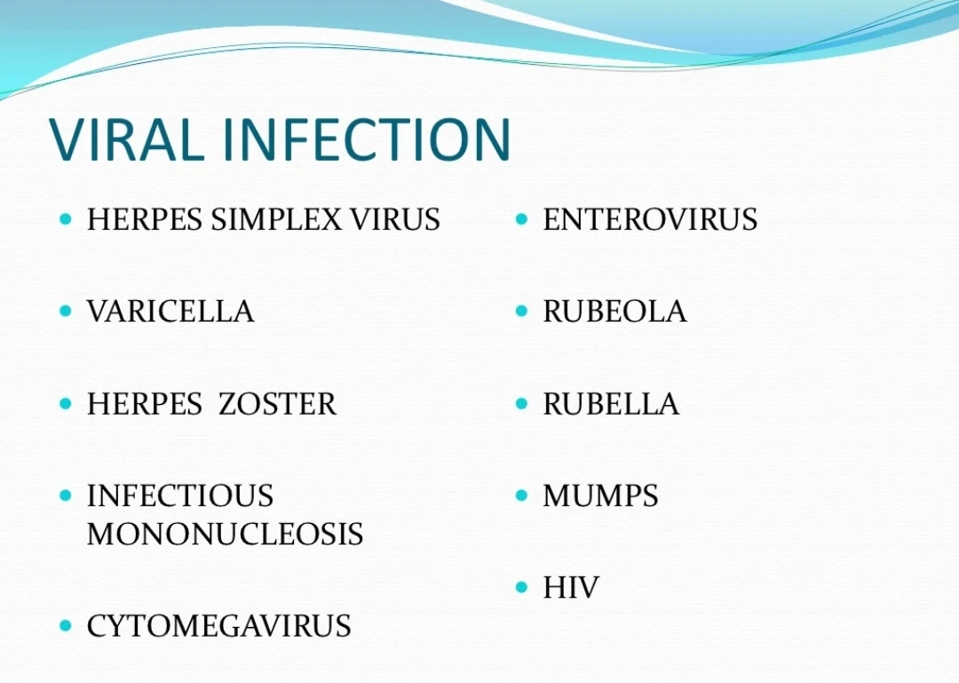

Slide 5
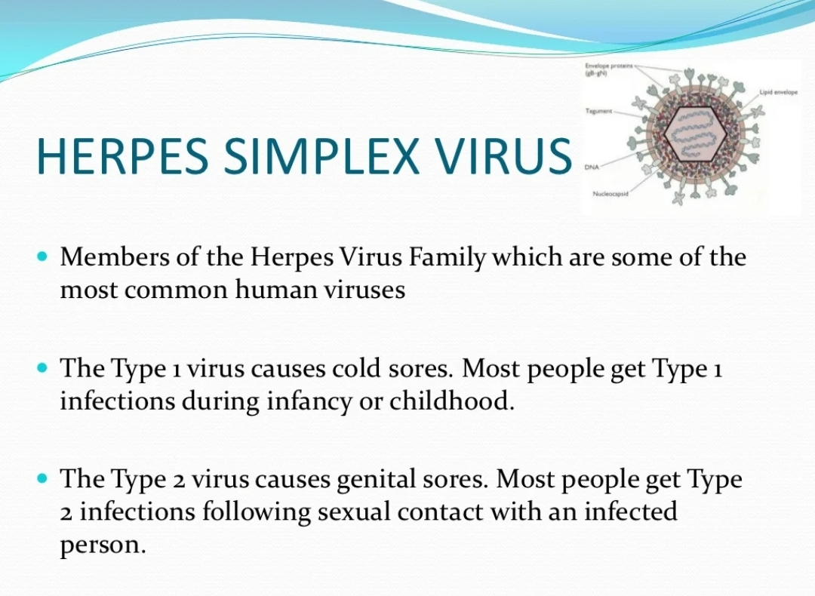

Slide 6
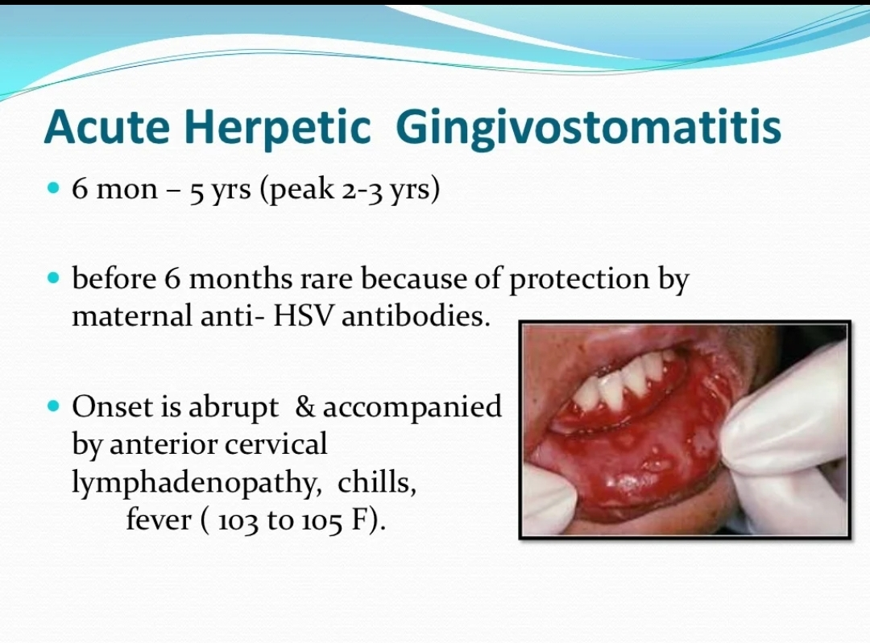

Slide 7
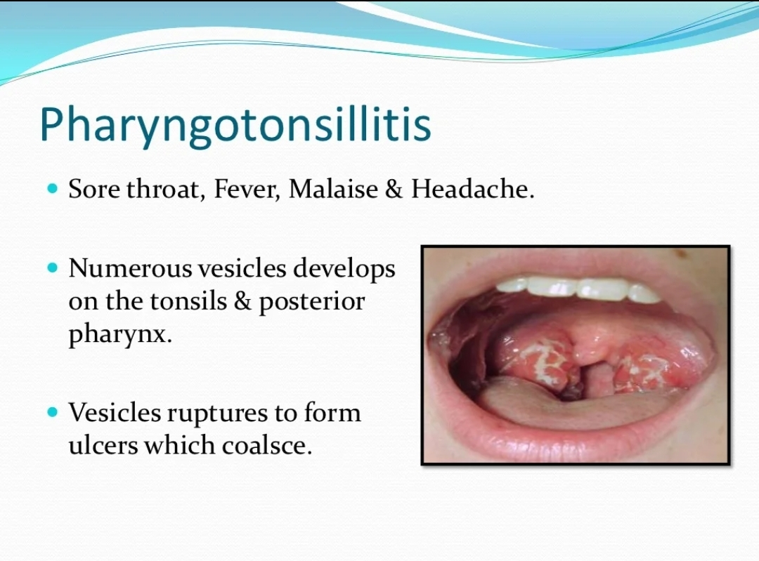

Slide 8
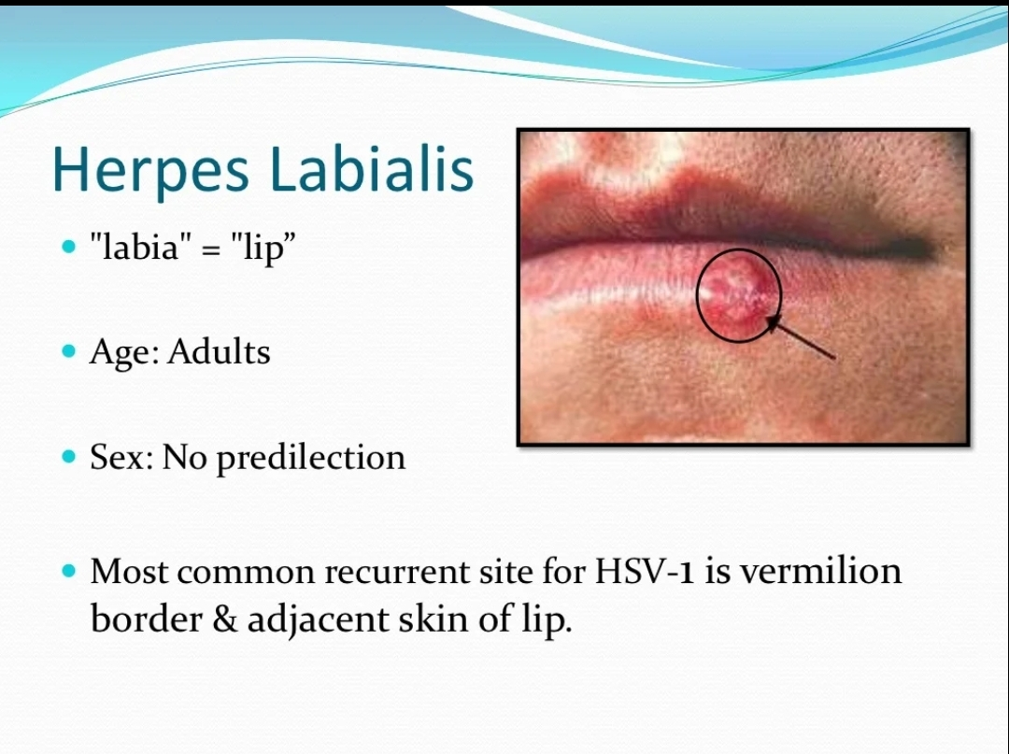

Slide 9
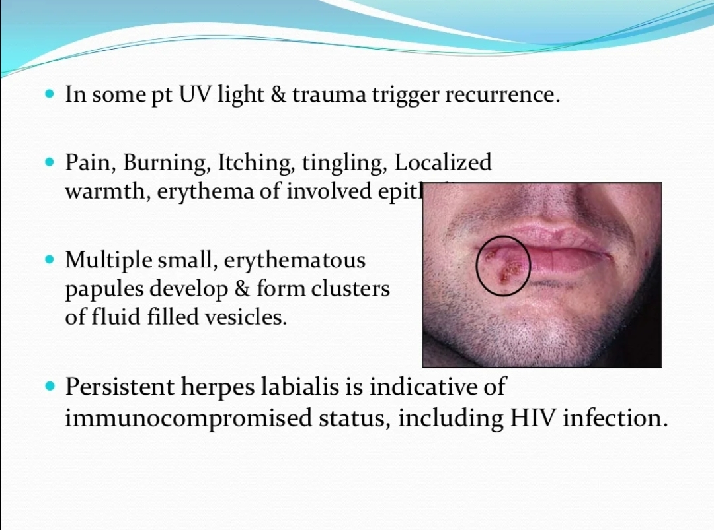

Slide 10
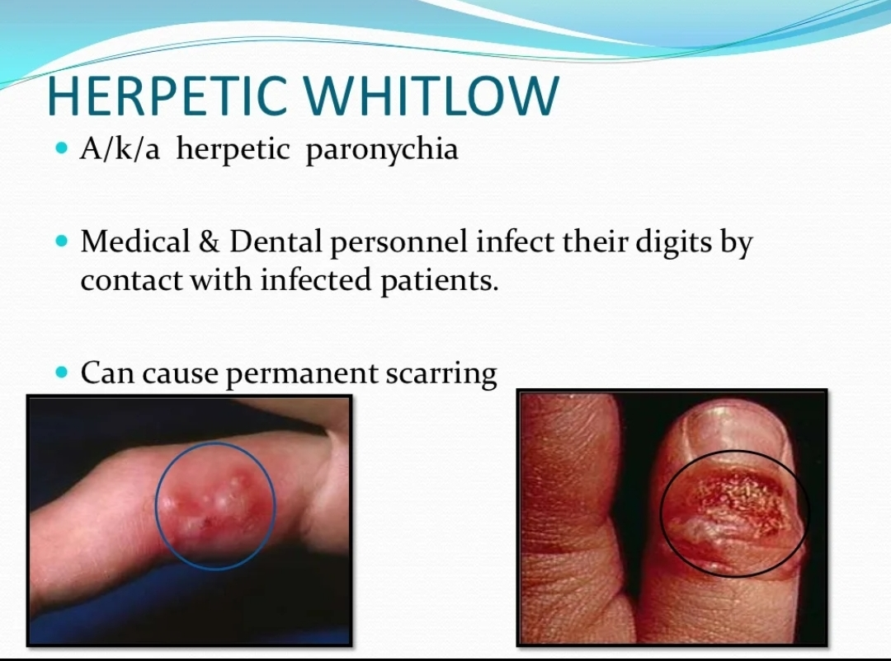

Slide 11
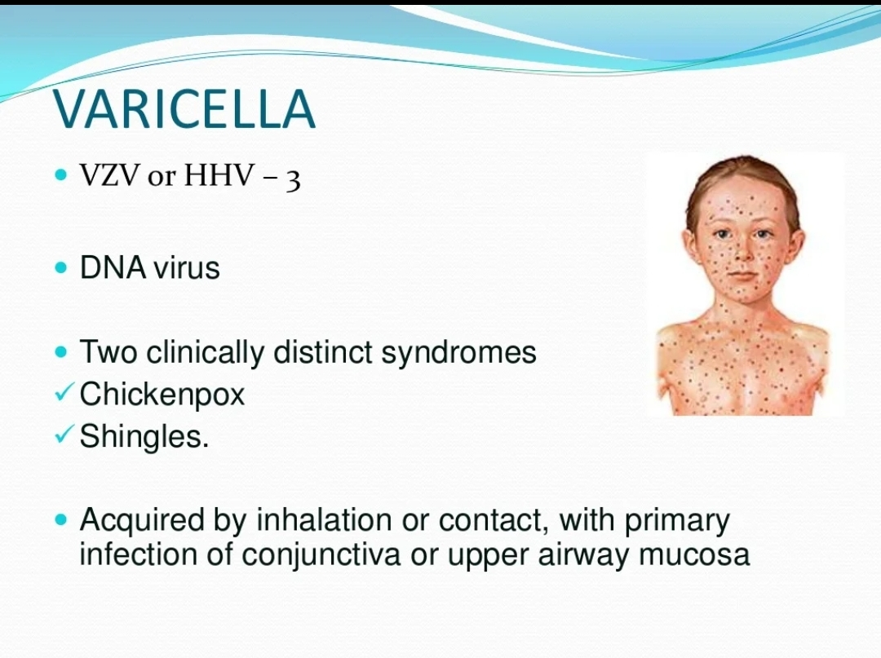

Slide 12
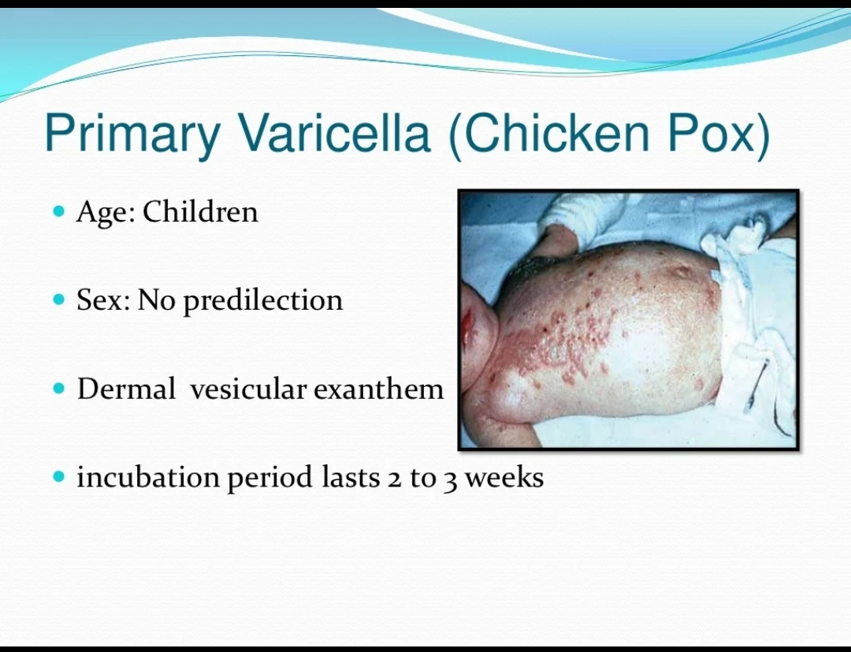

Slide 13
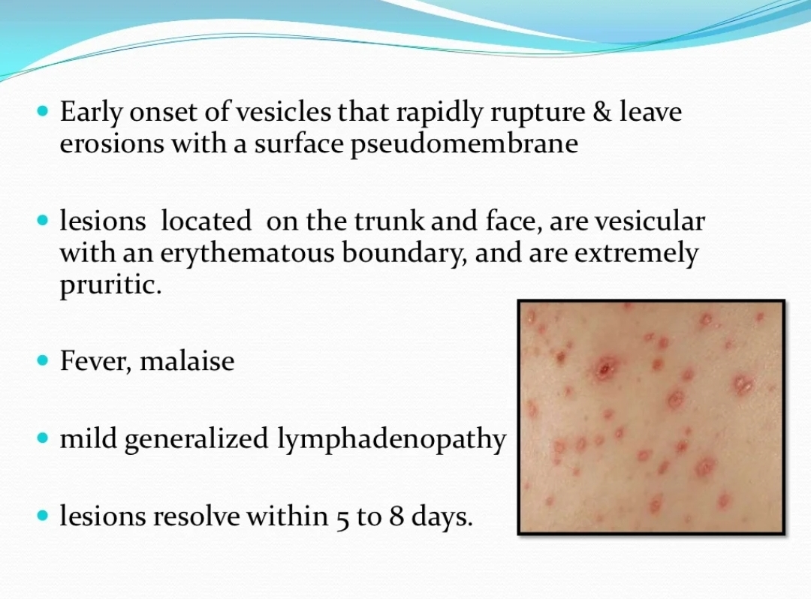

Slide 14
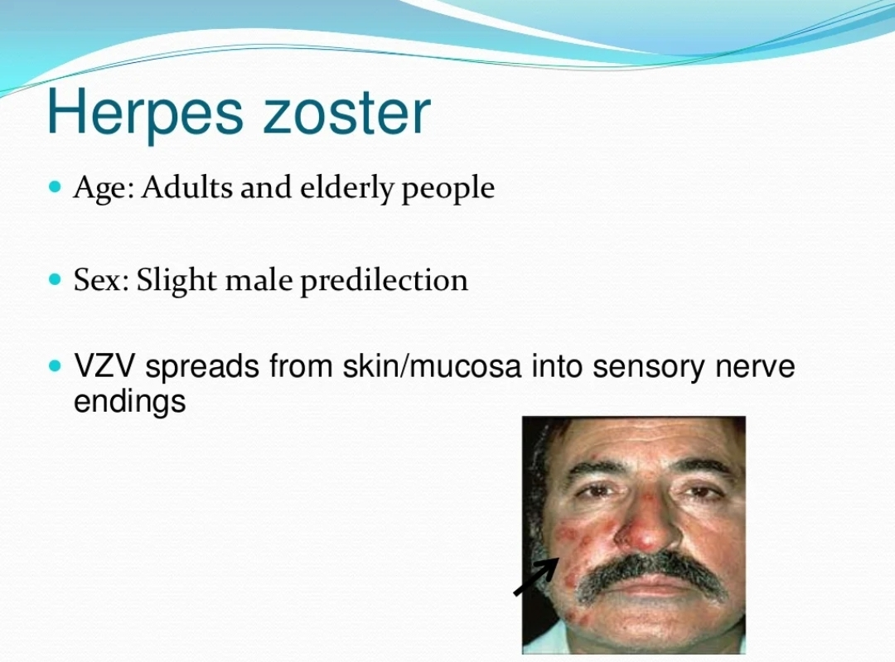

Slide 15
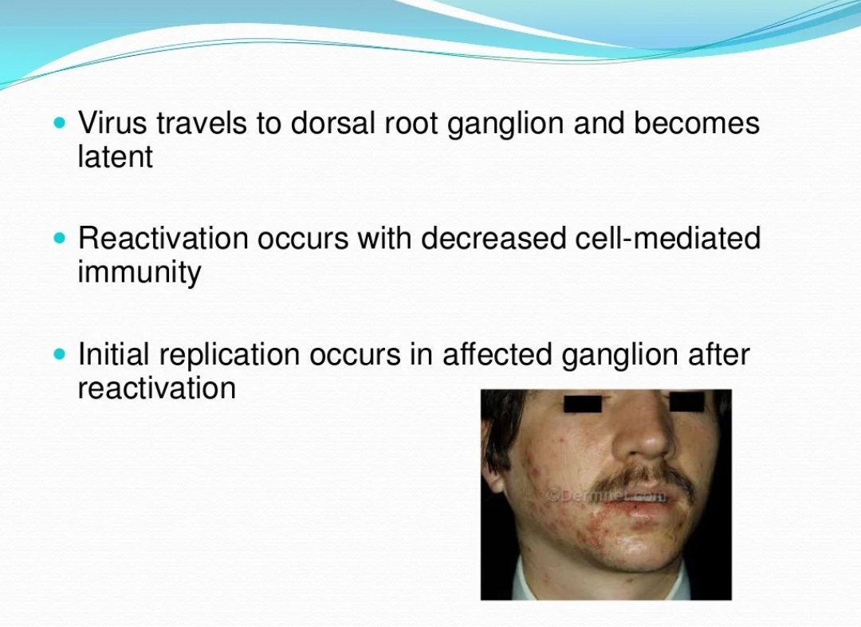

Slide 16
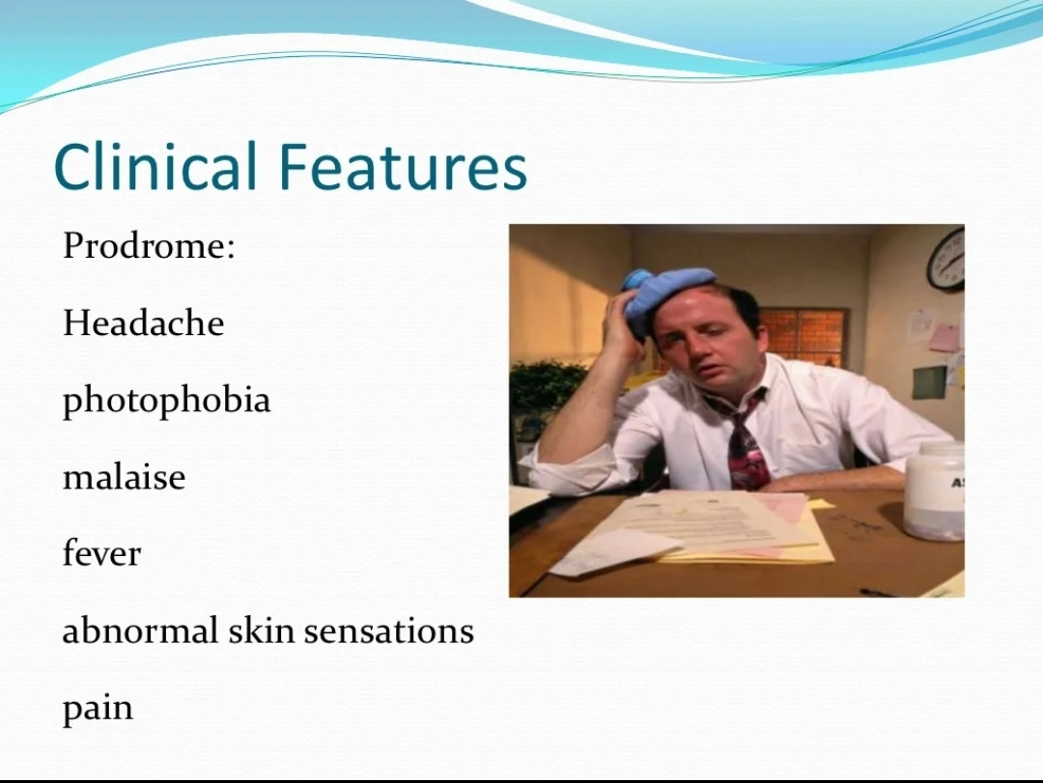

Slide 17
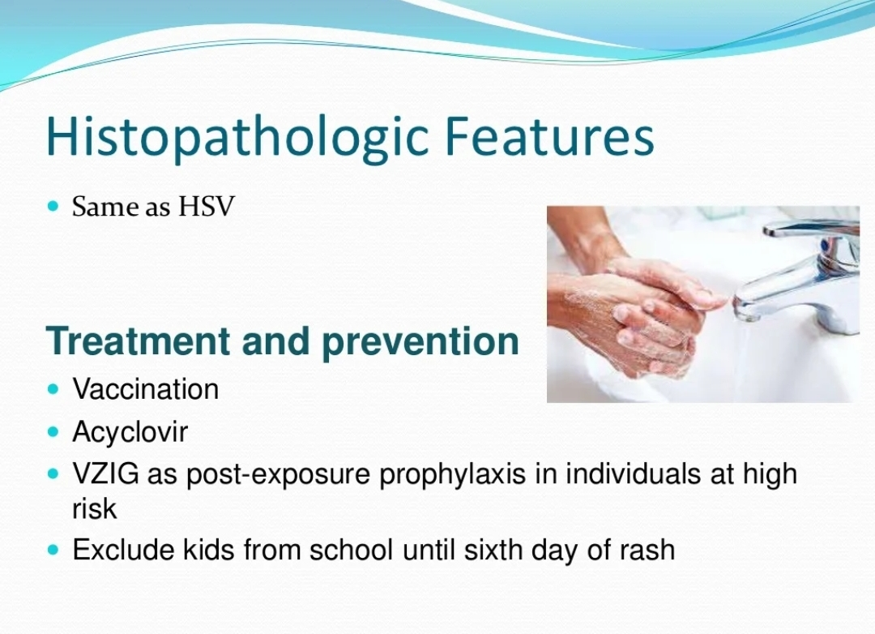

Slide 18
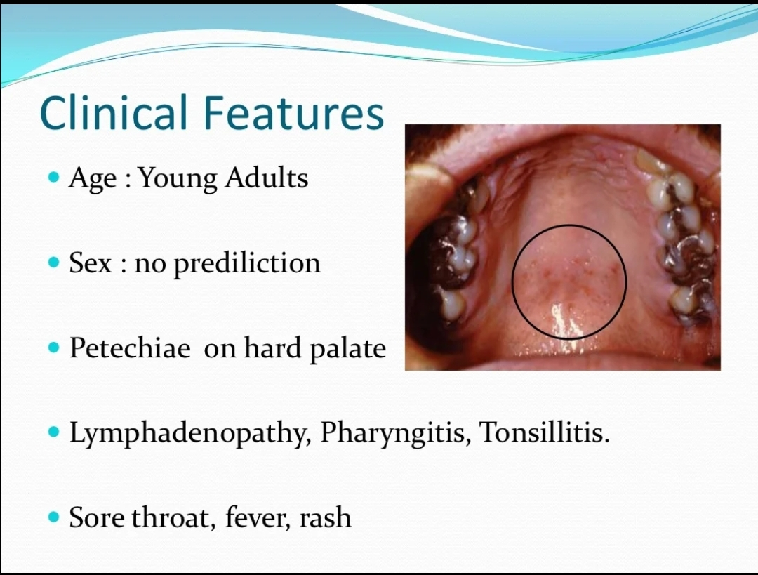

Slide 19
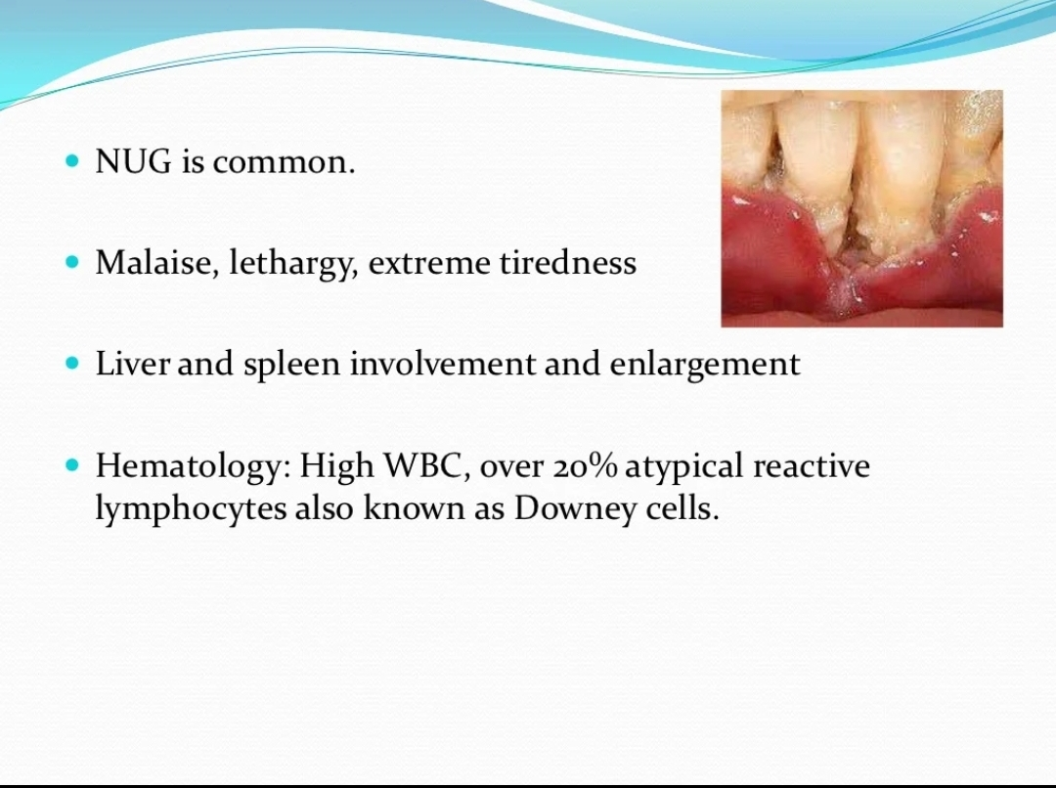

Slide 20
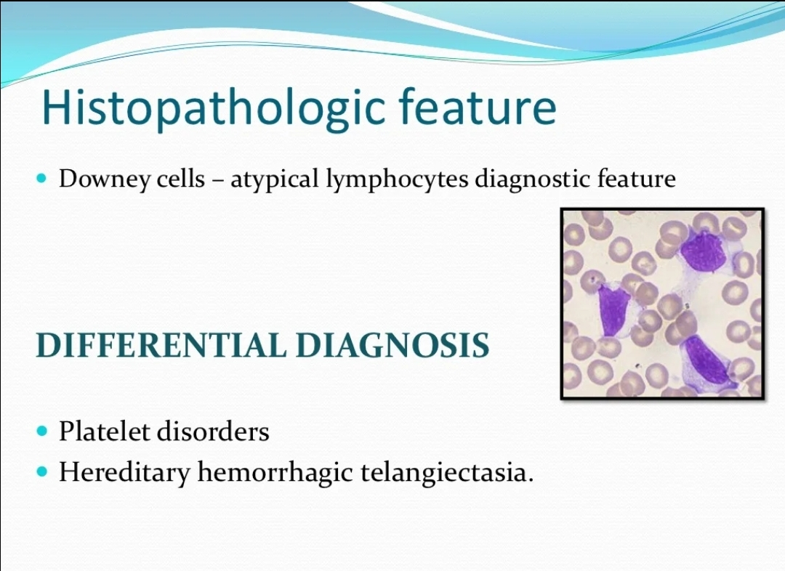

Slide 21
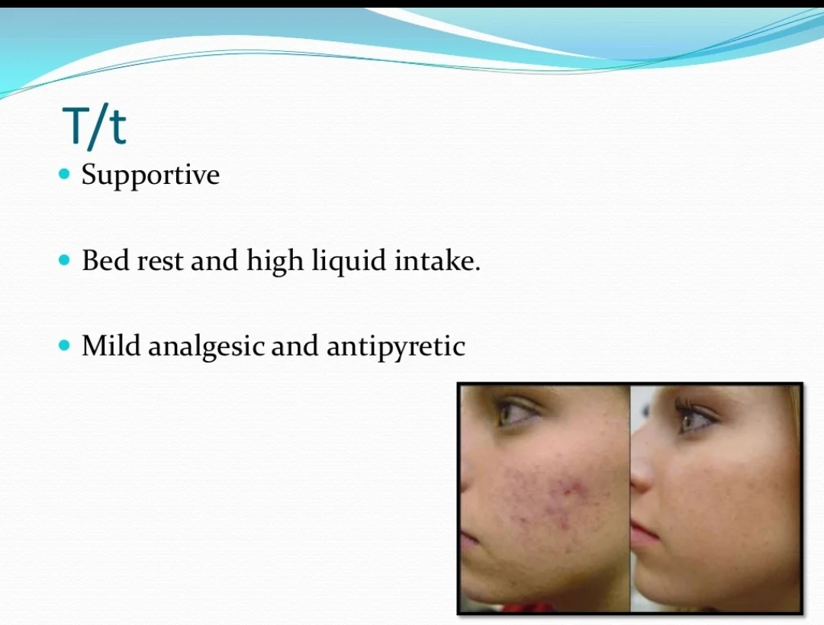

Slide 22
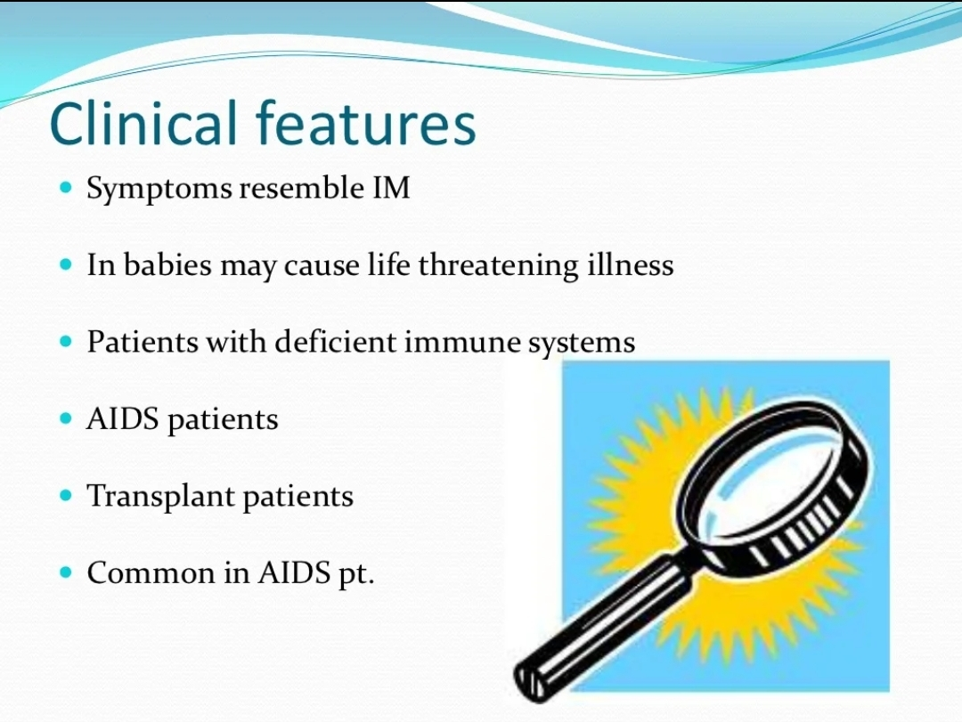

Slide 23
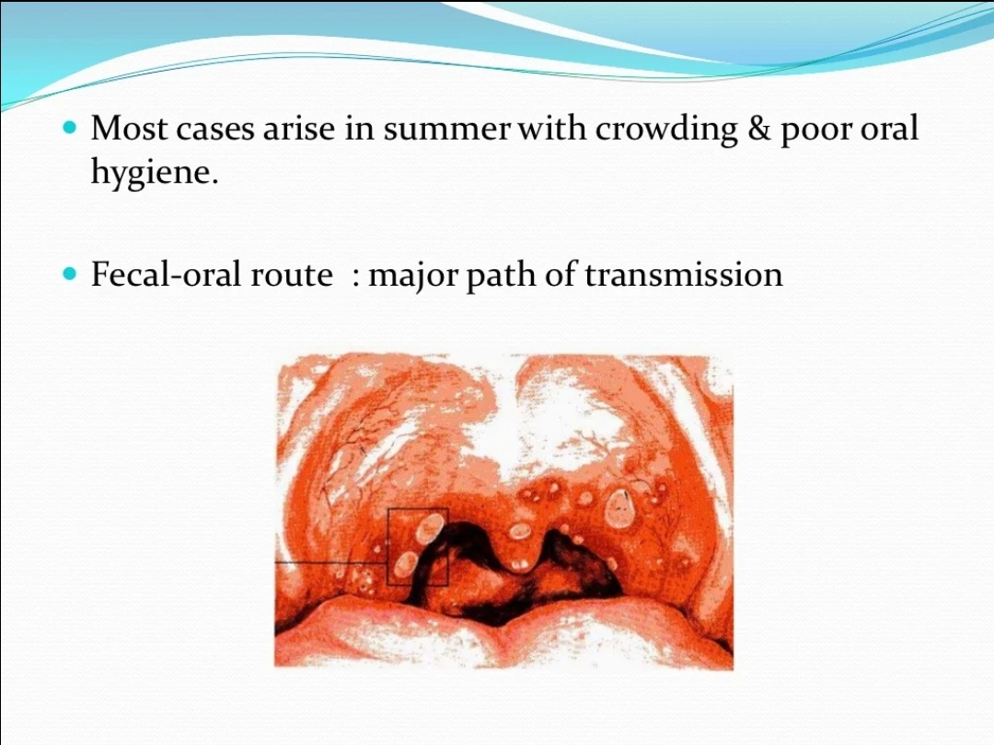

Slide 24
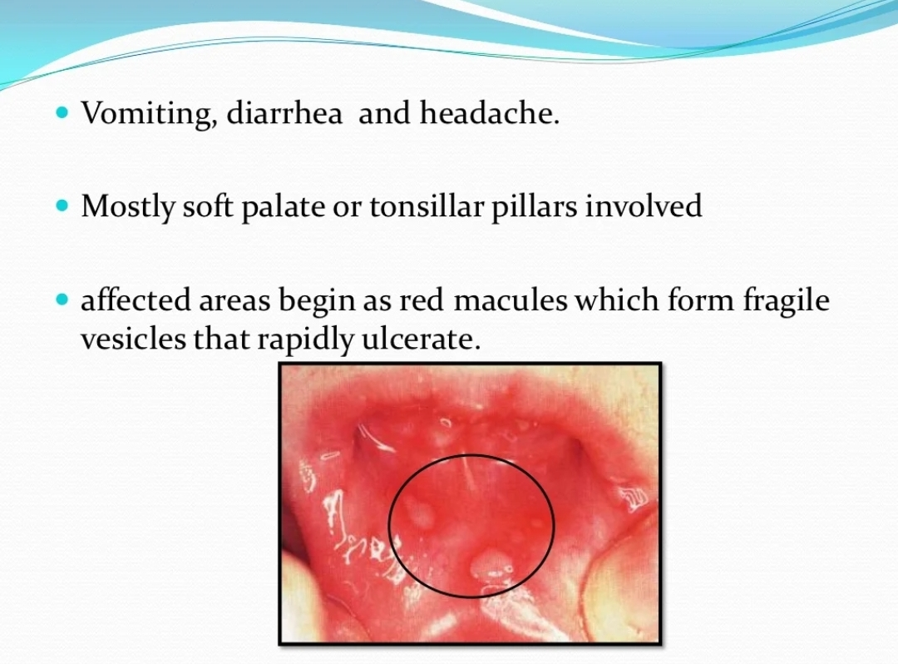

Slide 25
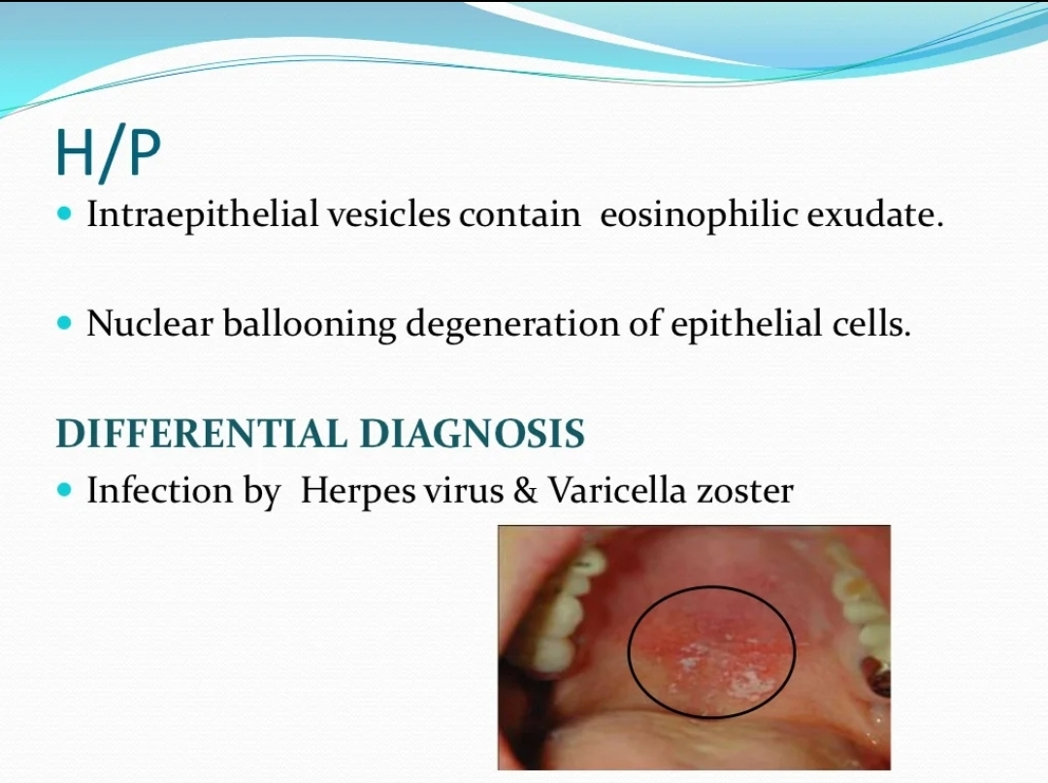

Slide 26
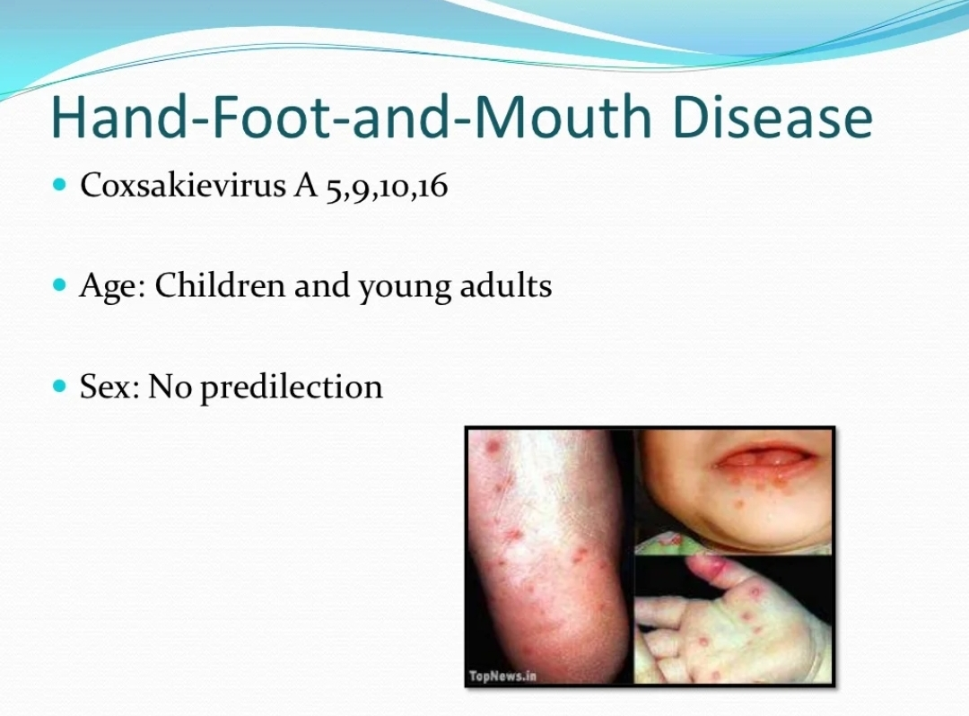

Slide 27
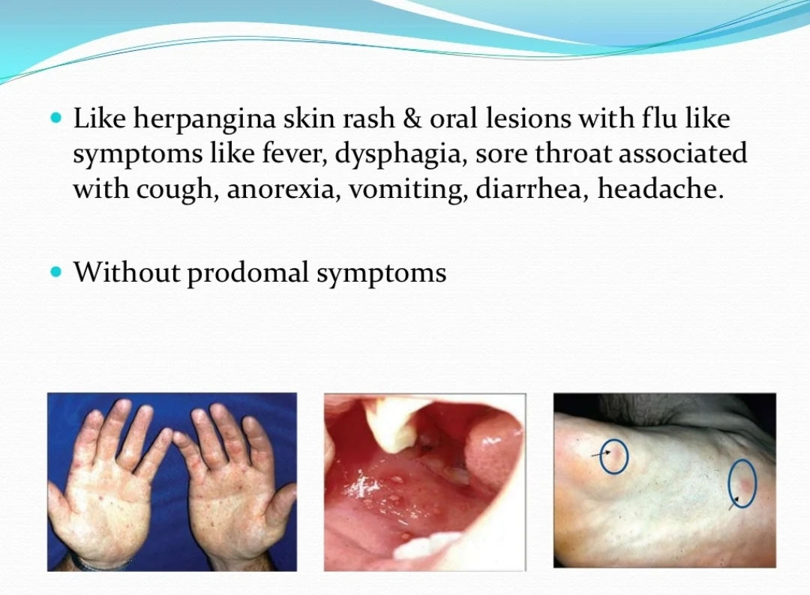

Slide 28
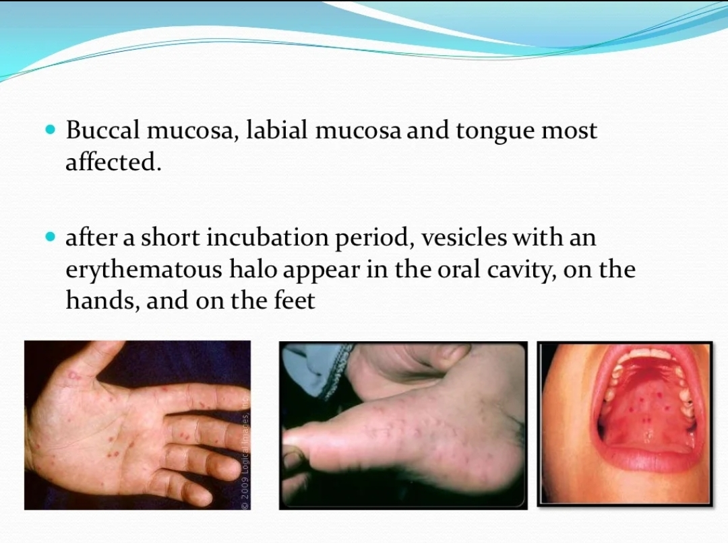

Slide 29
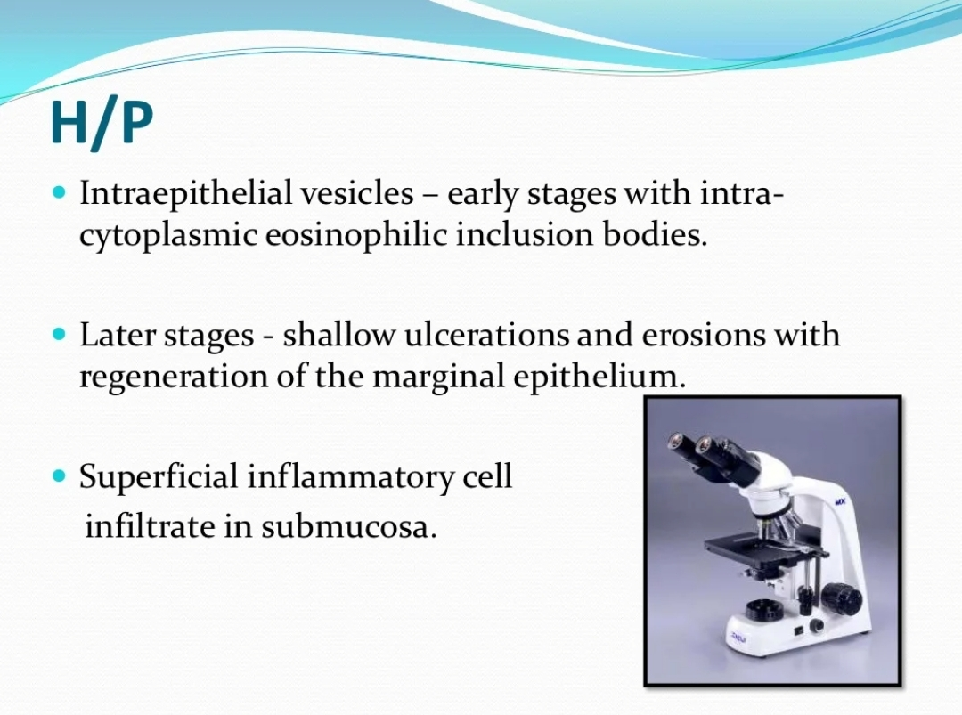

Slide 30
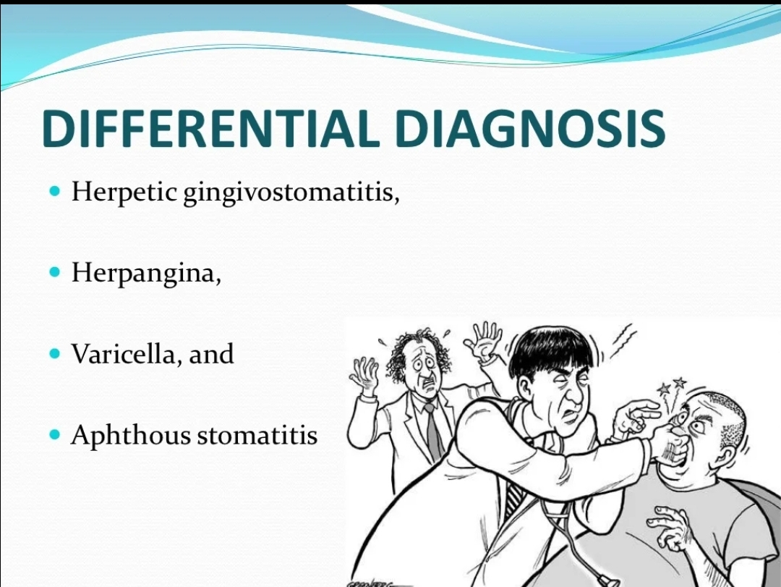

Slide 31
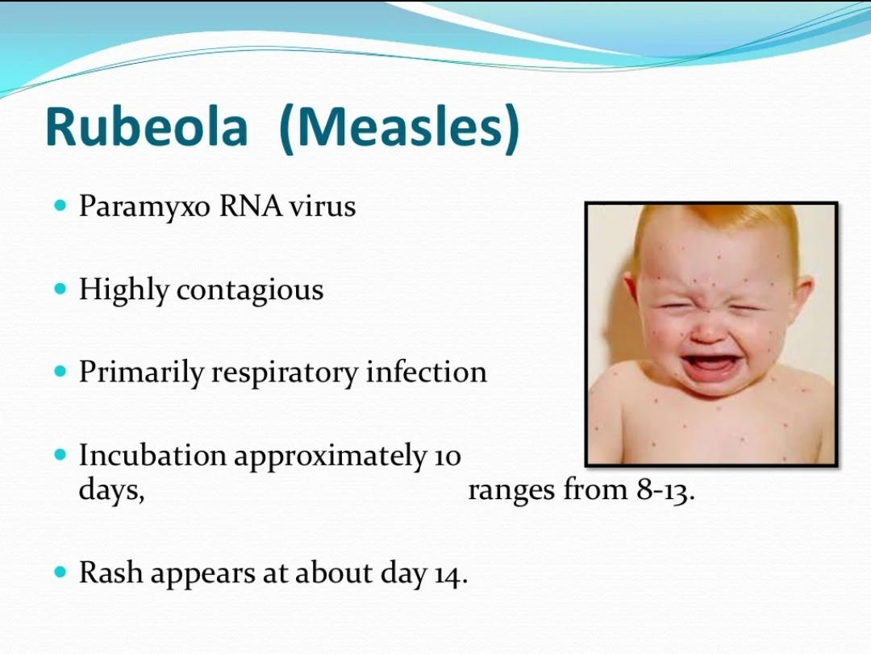

Slide 32
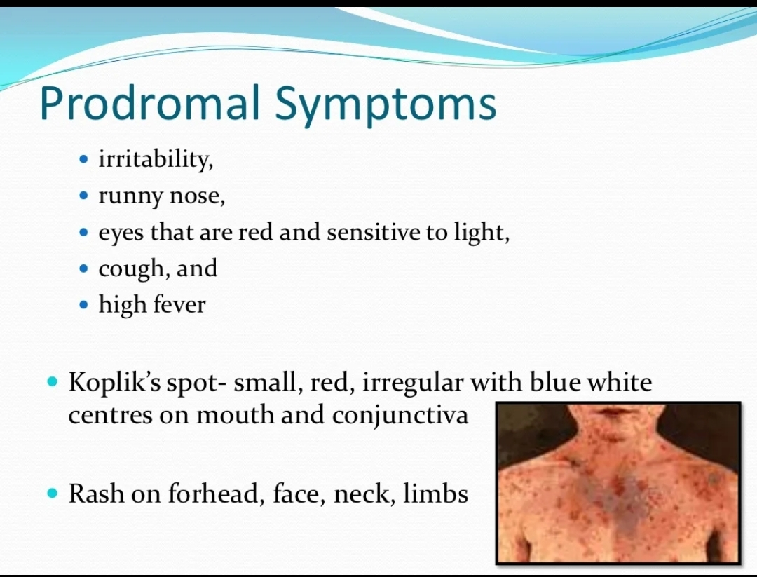

Slide 33
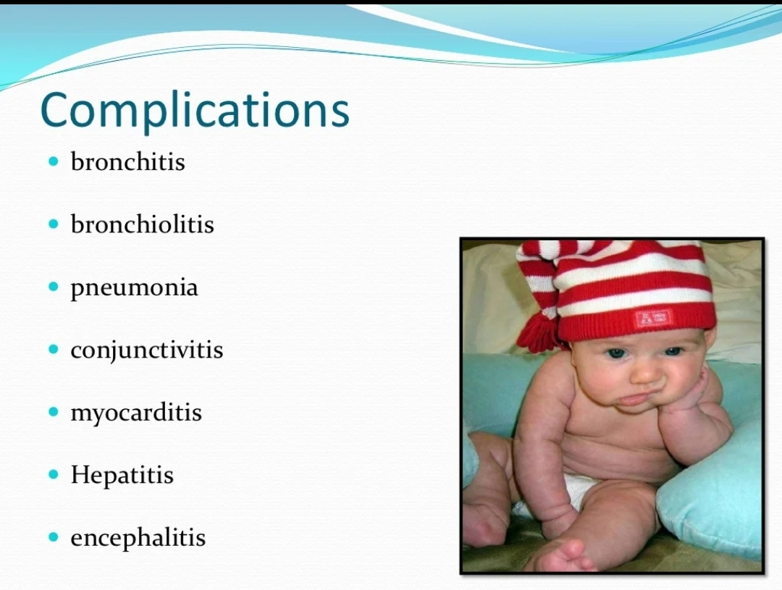

Slide 34

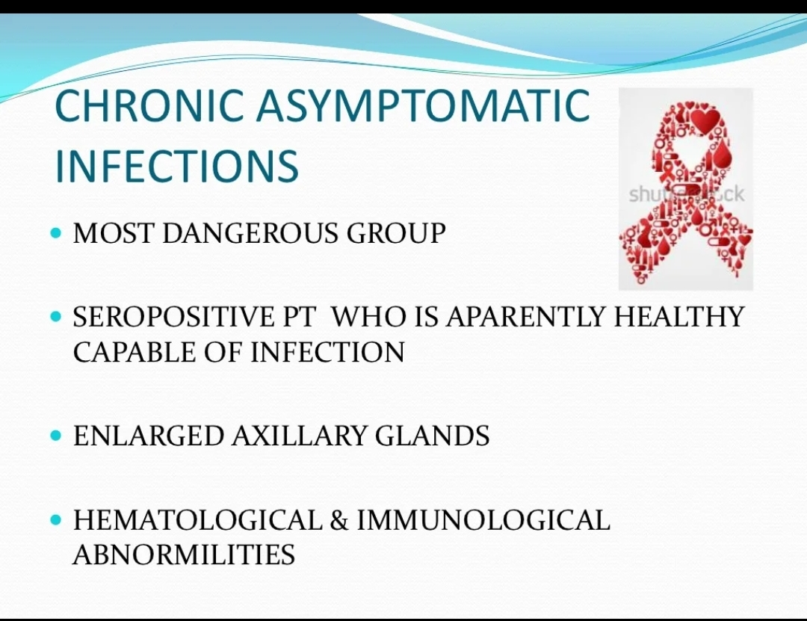
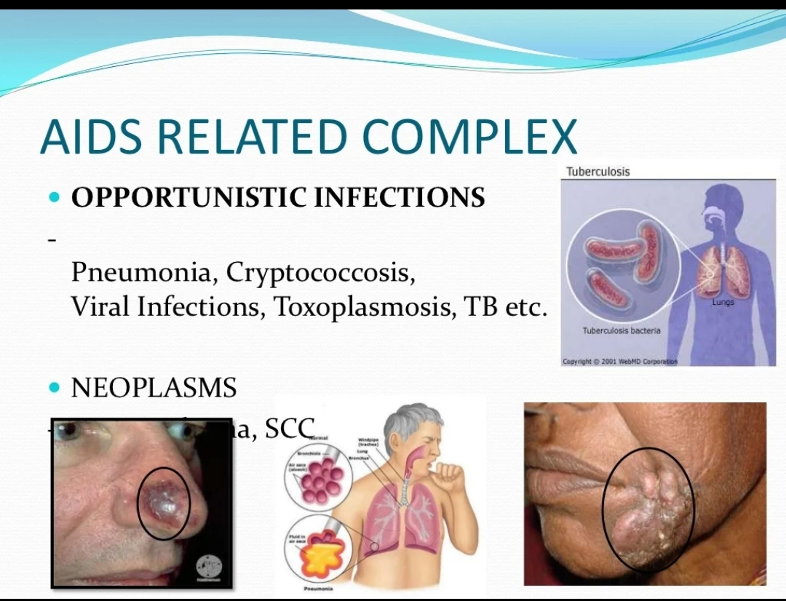
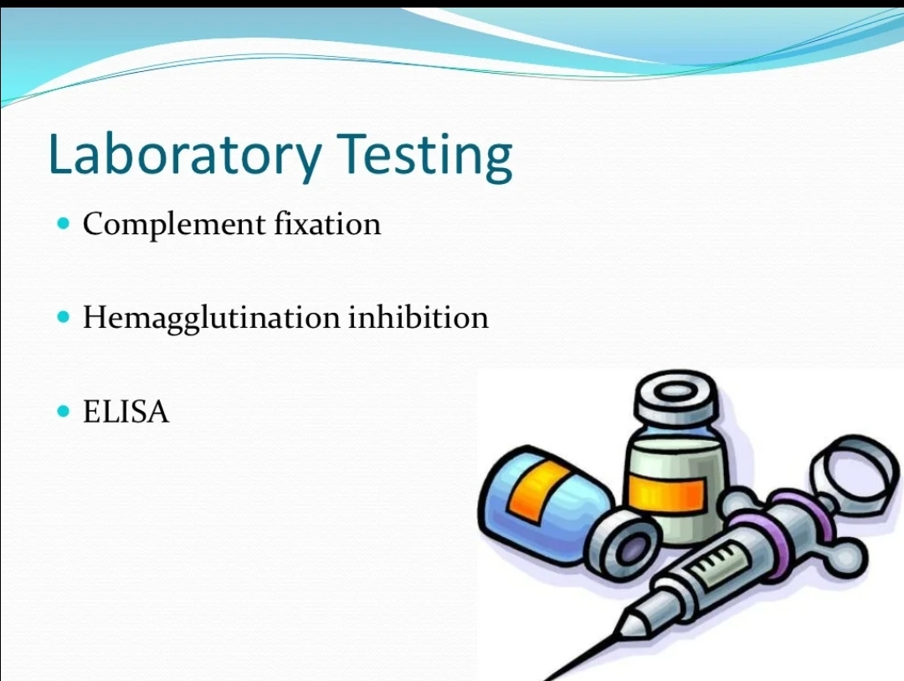
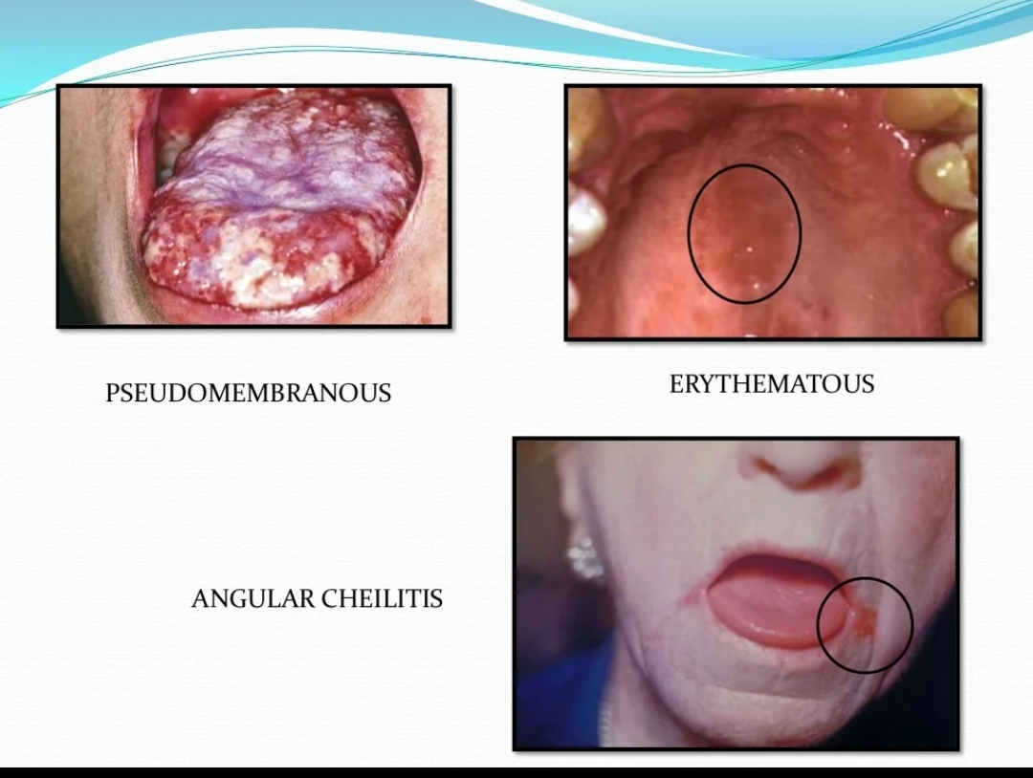
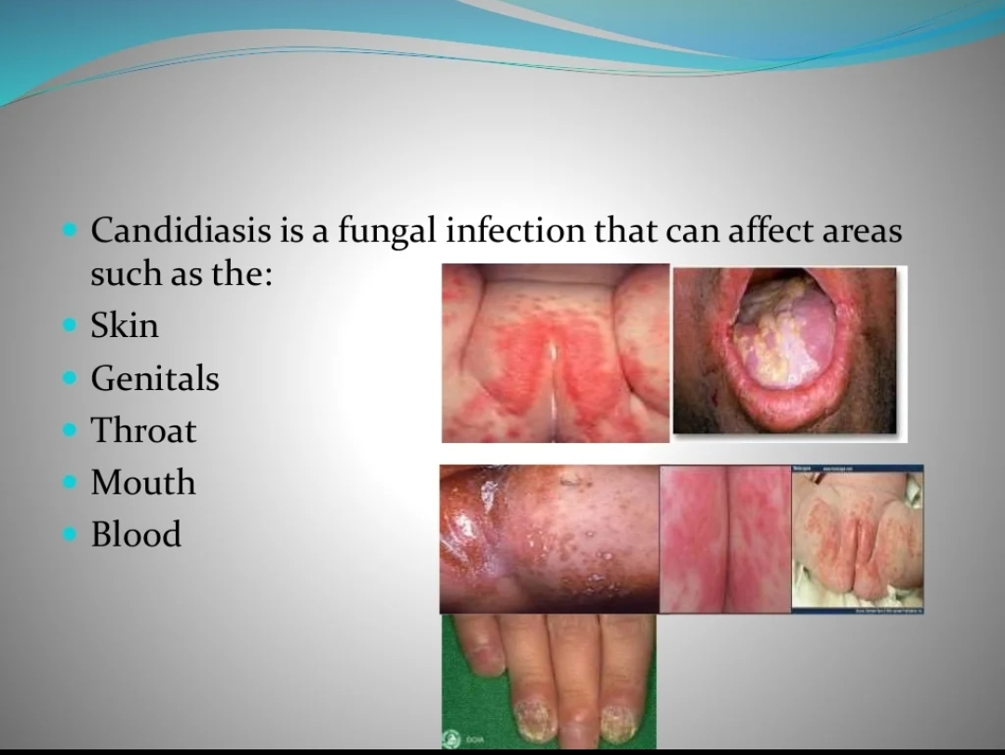
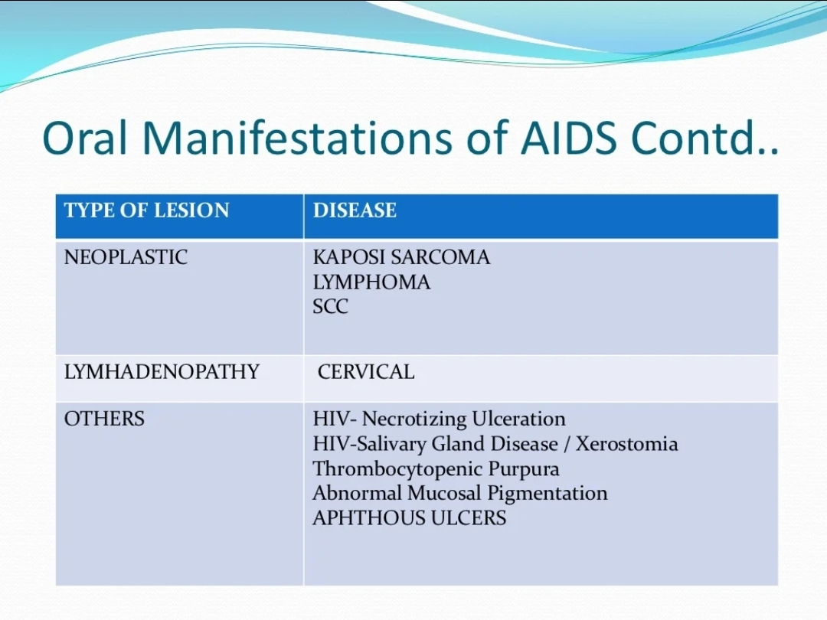
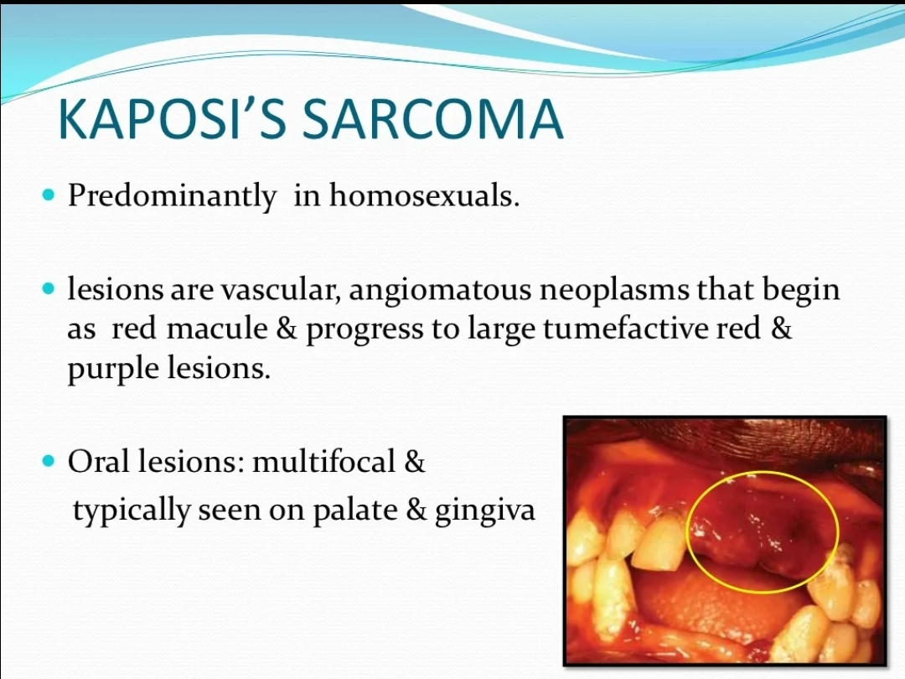
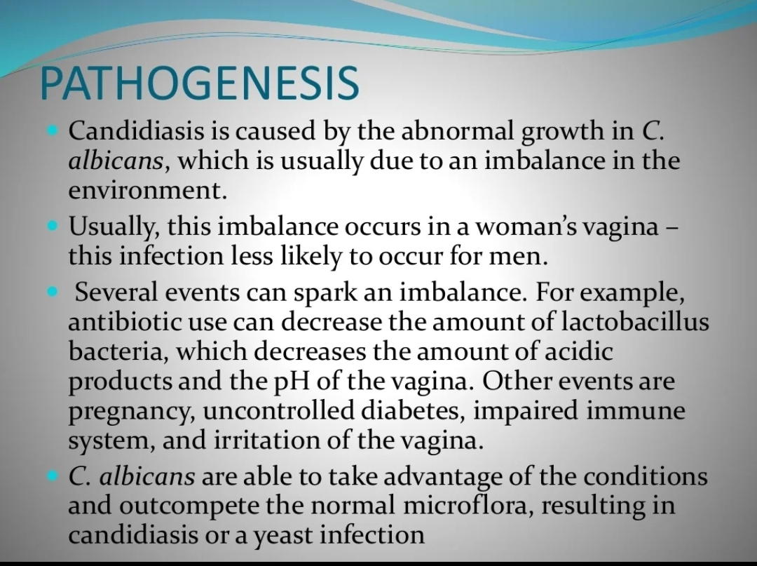
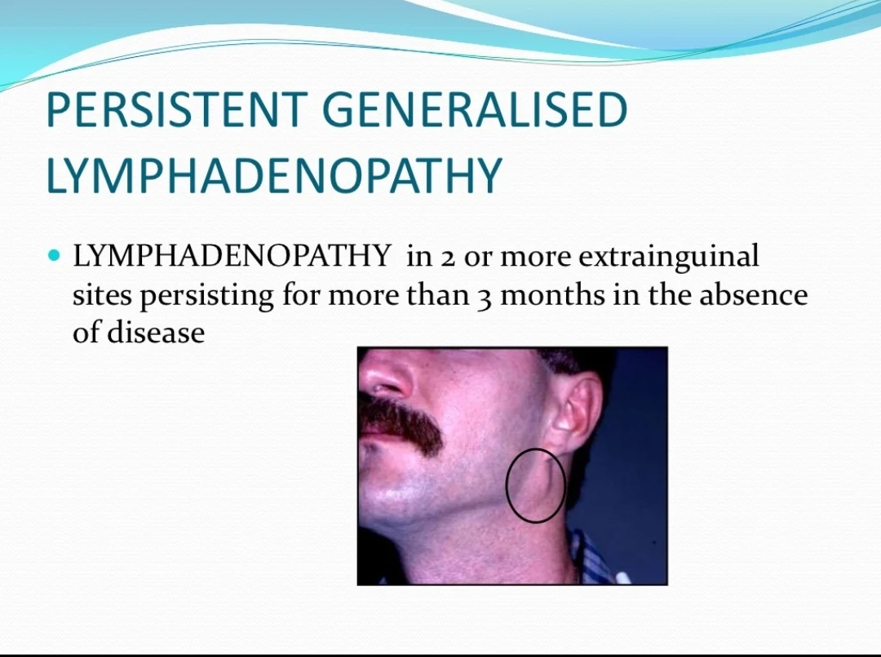
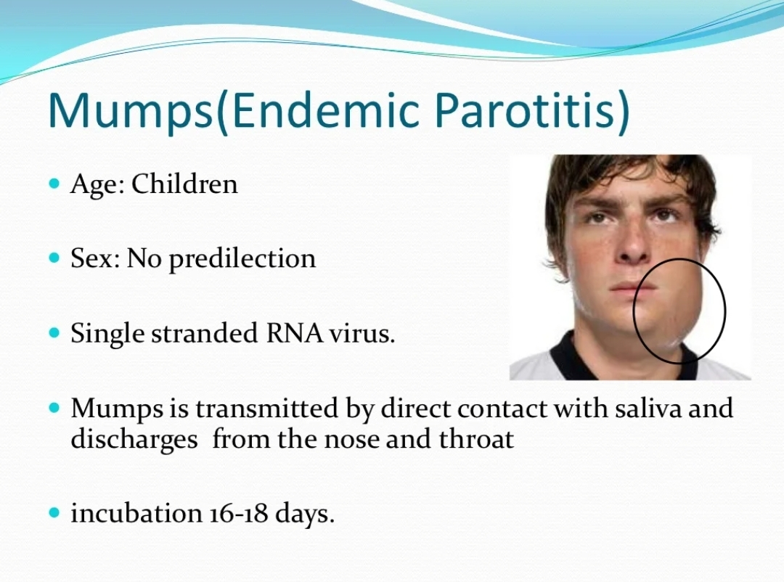
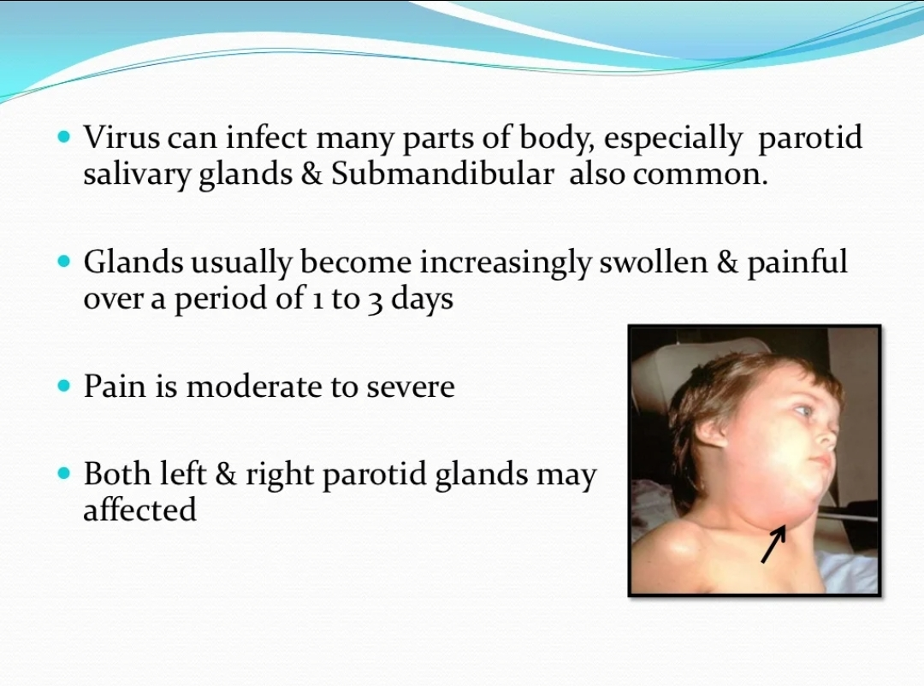
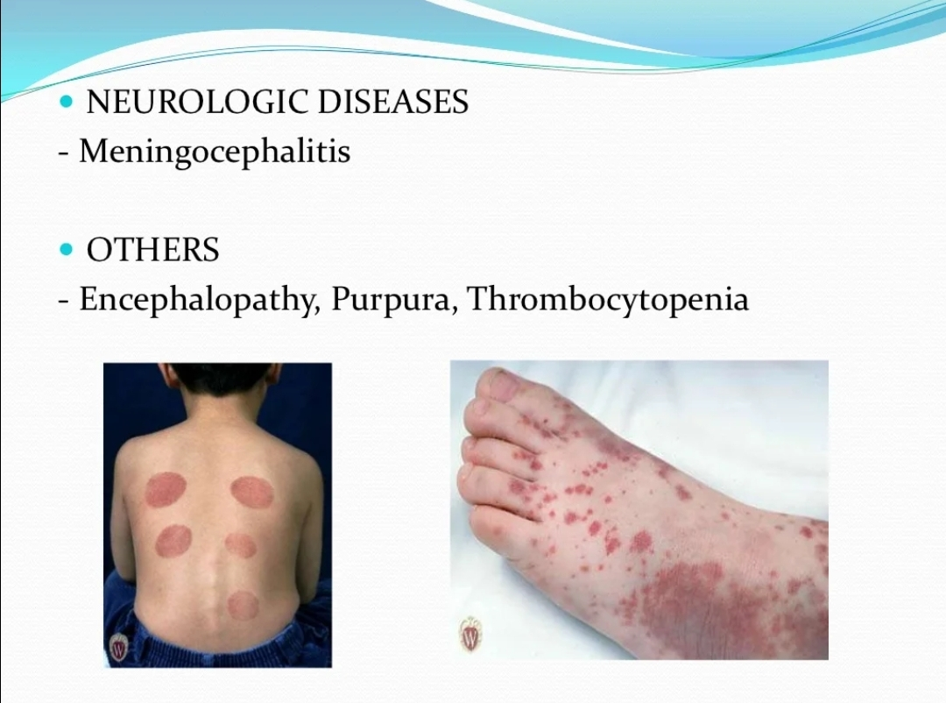
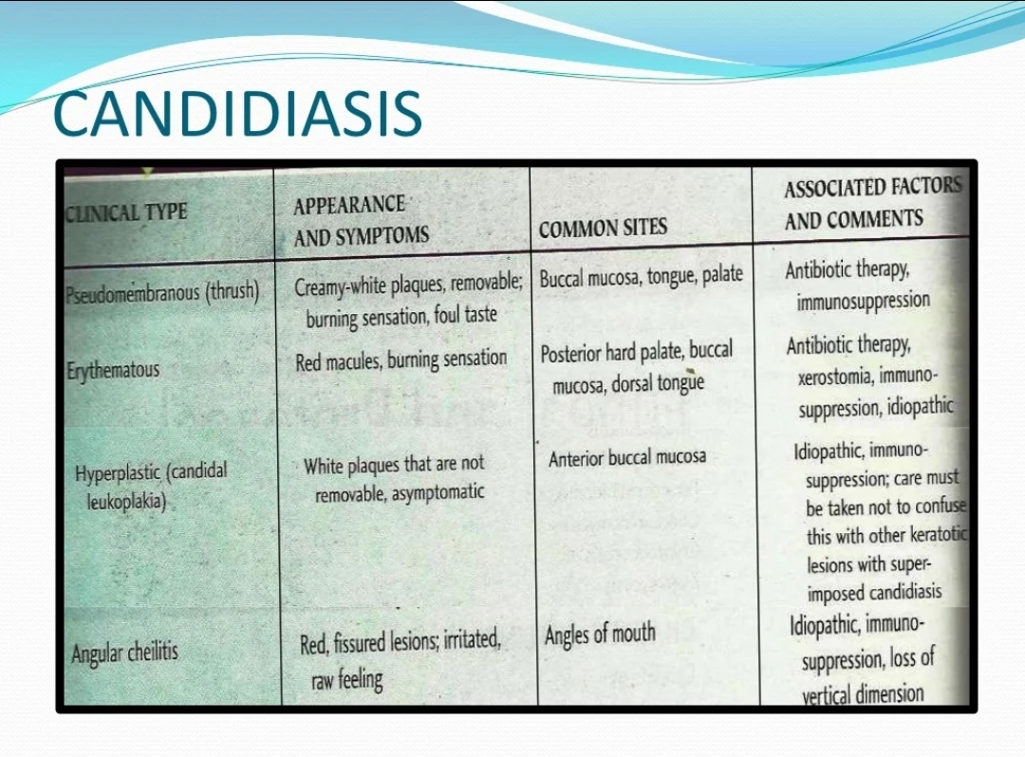
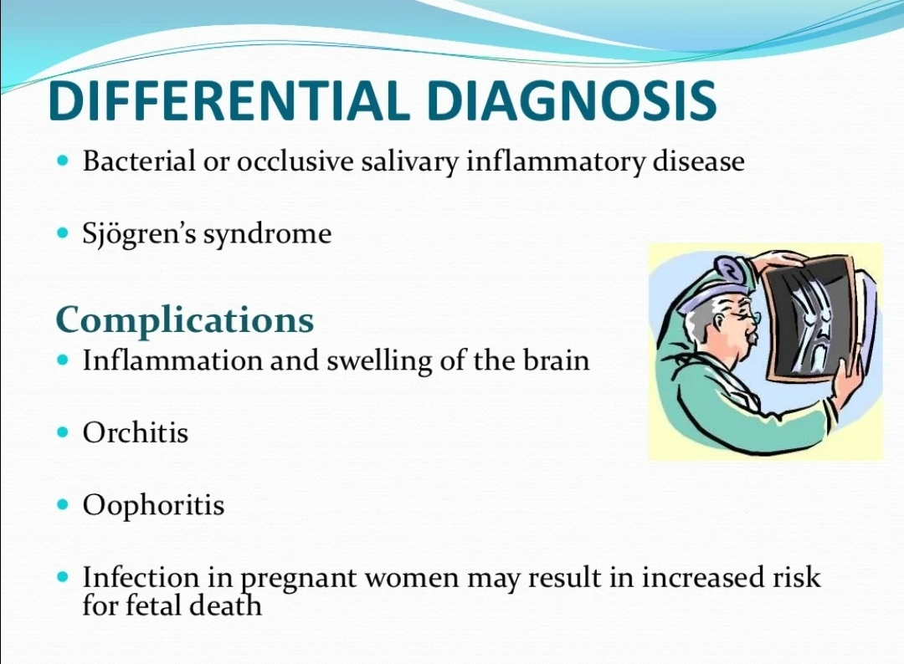
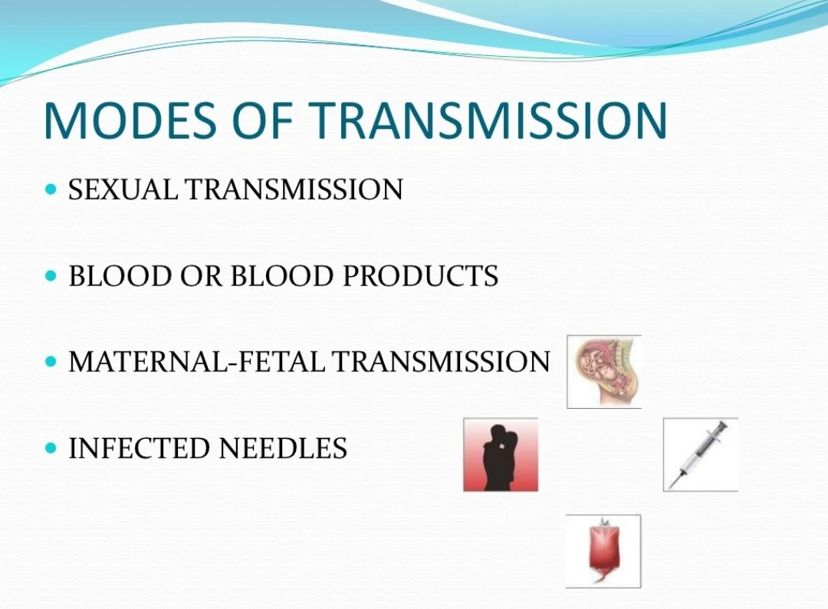
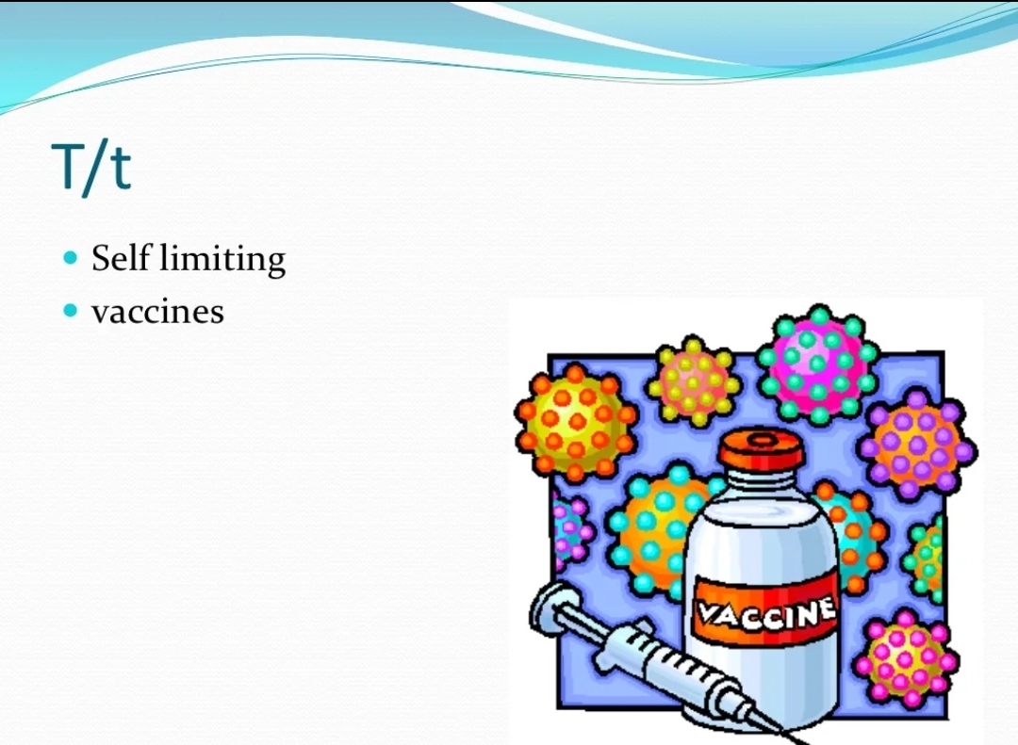
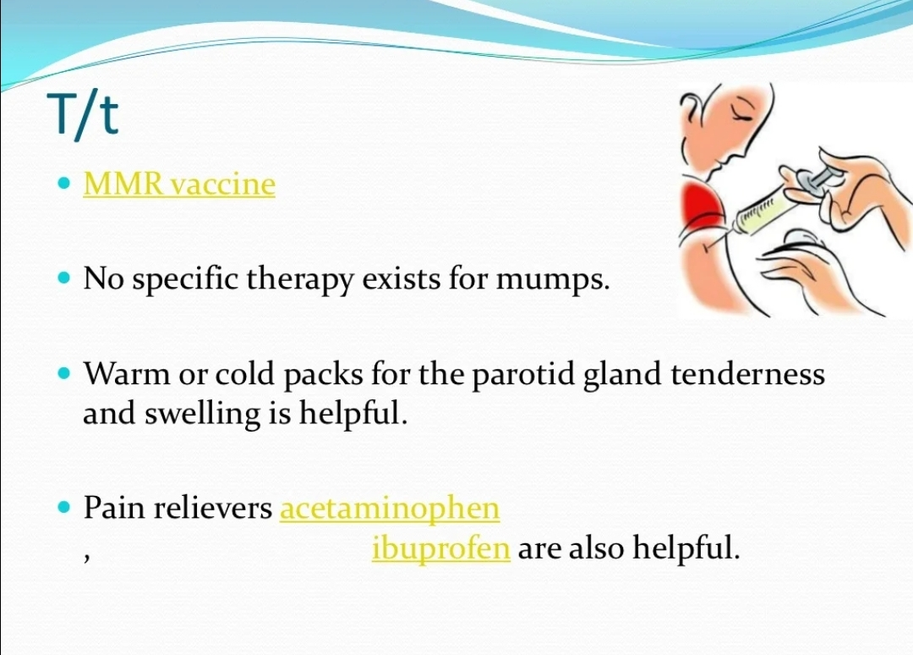
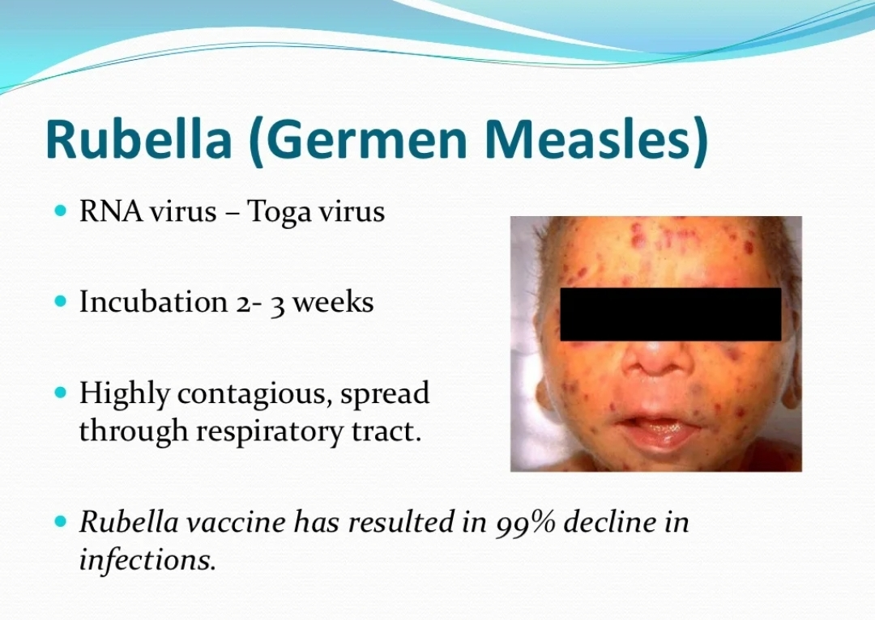
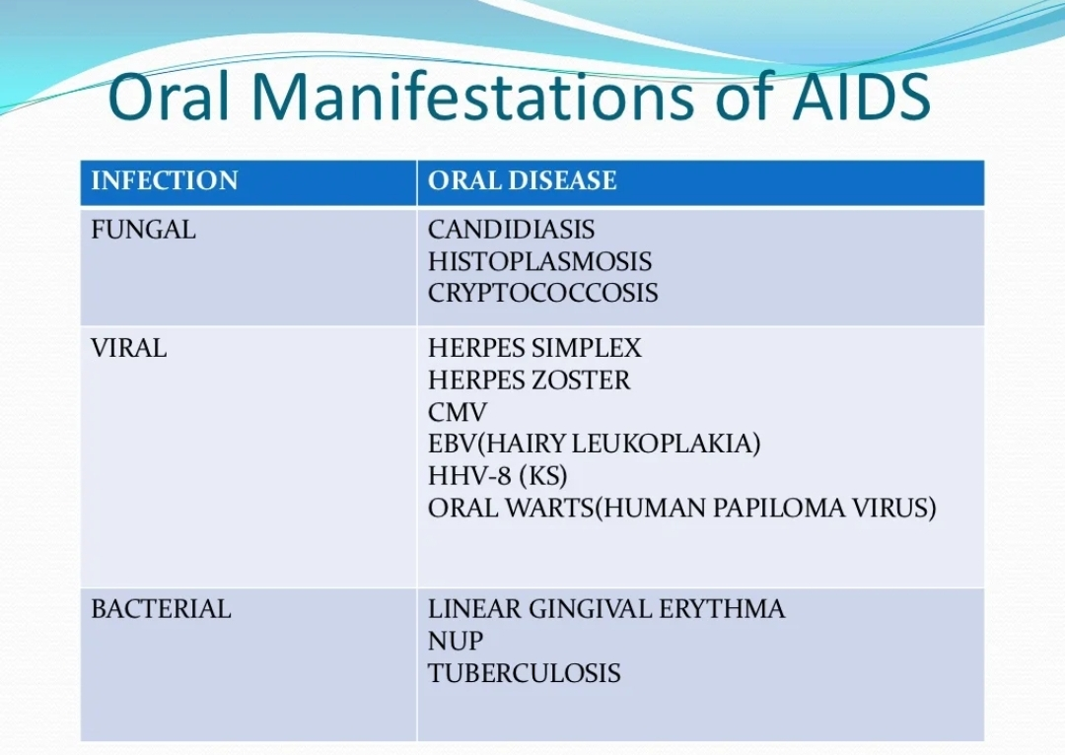
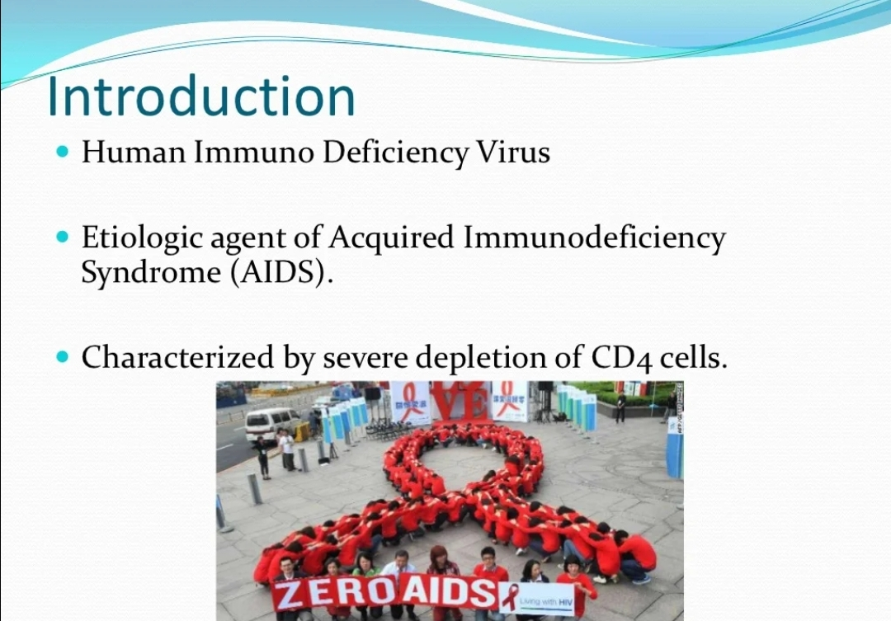

Slide 55
Take home message
Viral infection of the oral cavity usually manifest as either ulceration or blistering presentation of oral tissues
Oral viral infection are encountered in dental practice but received less clinical interest due to the lesser frequency of patients and diagnostic challenges

Slide 56
Question & Answer Session
DESCRIBE MUMPS.
ORAL MENIFESTATIONS OF HIV
KAPOSI SARCOMA
TYPES OF CANDIDIASIS
WRITE ABOUT ACUTE HERPETIC GINGIVOSTOMATITIS.
HERPES LABIALIS

Slide 57
REFERENCES
NAME OF THE BOOK WITH EDITION AND PAGE NUMBERS
ARTICLE ARE TO BE MENTIONED IF NEEDED
SHAFER’S 9th EDITION
LUCAS
NEVILLE
REGEZI

Slide 58
THANK YOU

